Slide 1
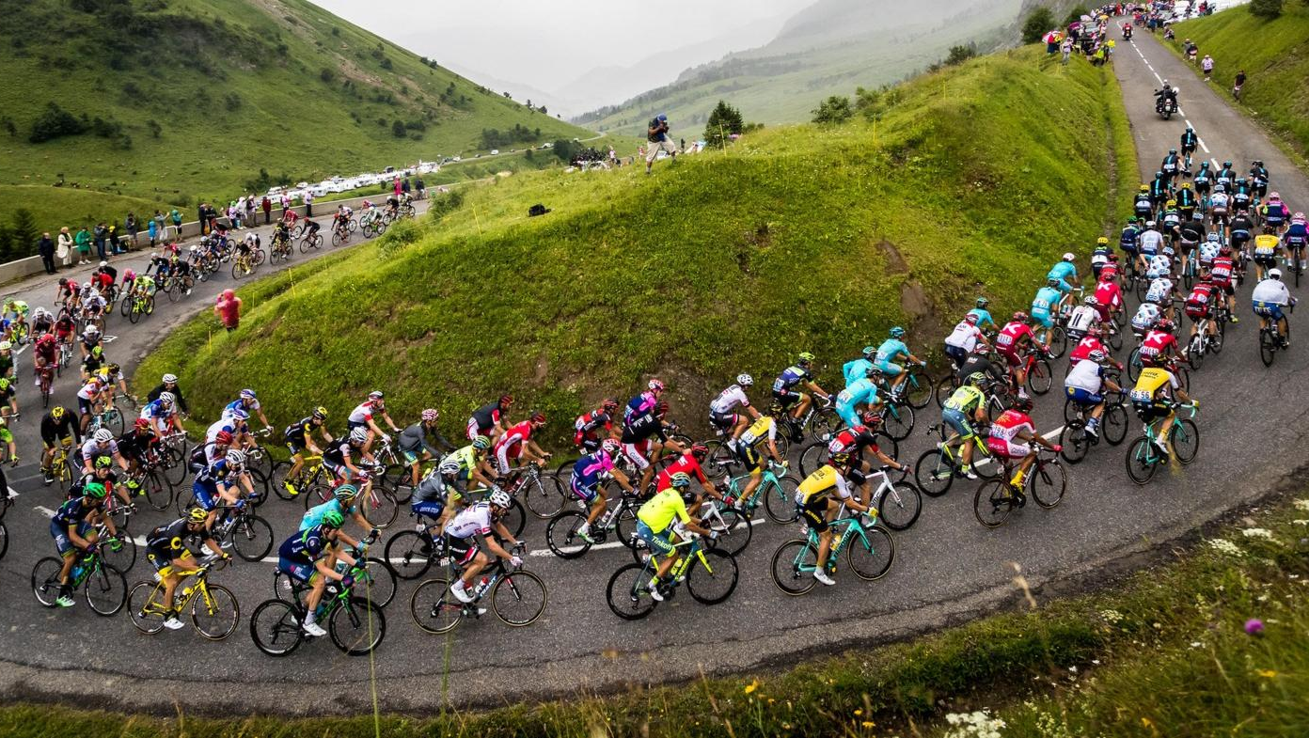
TOUR DE FRANCE PREDICTION
Presented by:
Subbu Kandhaswamy
Anousha ZafaRipour
Addie Van Salisbury
Cindy Kyungae Kim
Ryan Geary
IST 718_ Dec 2021

Slide 2

Tour de France Prediction
Project Overview
Every summer, the world’s top cyclists gather in France for a grueling race across the country. It’s a cycling competition held in France every year (sometimes neighboring countries) and takes place in 21 stages with a course covering approximately 3,500 kilometers.
In this project, we want to predict what the future Tour de France will look like – specifically the pace and time of the next winner. Additionally, we hope to explore the data and describe the ideal cyclist. This is important because it allows us to understand which cyclist, we should invest in.

Slide 3
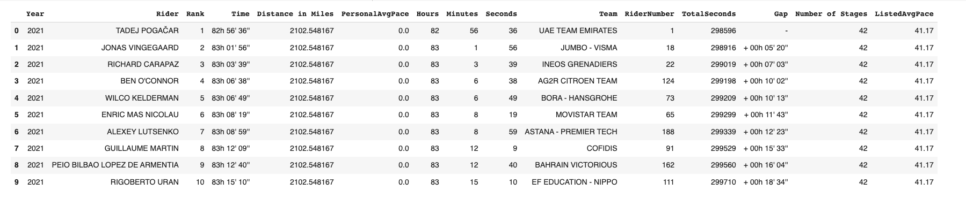
Reading and exploring the Data
Acquire data directly from the official Tour de France website (html parser) which contains rider information for each race from 1903 up to 2020
Along with an additional dataset from Kaggle on winner demographics
Data has 9208 rows and 18 columns
Describe method to show a quick statistical summary of our numerical columns
Drop columns that doesn't provide value to our analysis
Convert the distance from km to miles
Rename few columns

Slide 4
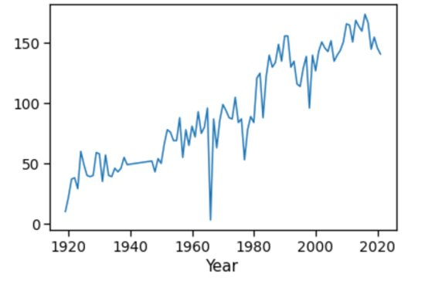
Analyzing the Data
Compute the number of riders each year. The massive drop of riders in 1966 is a bit unusual.
The Biggest TdF Scandals: 1966—The First Drug Tests

Slide 5
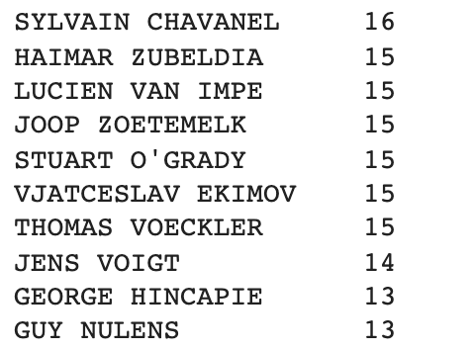
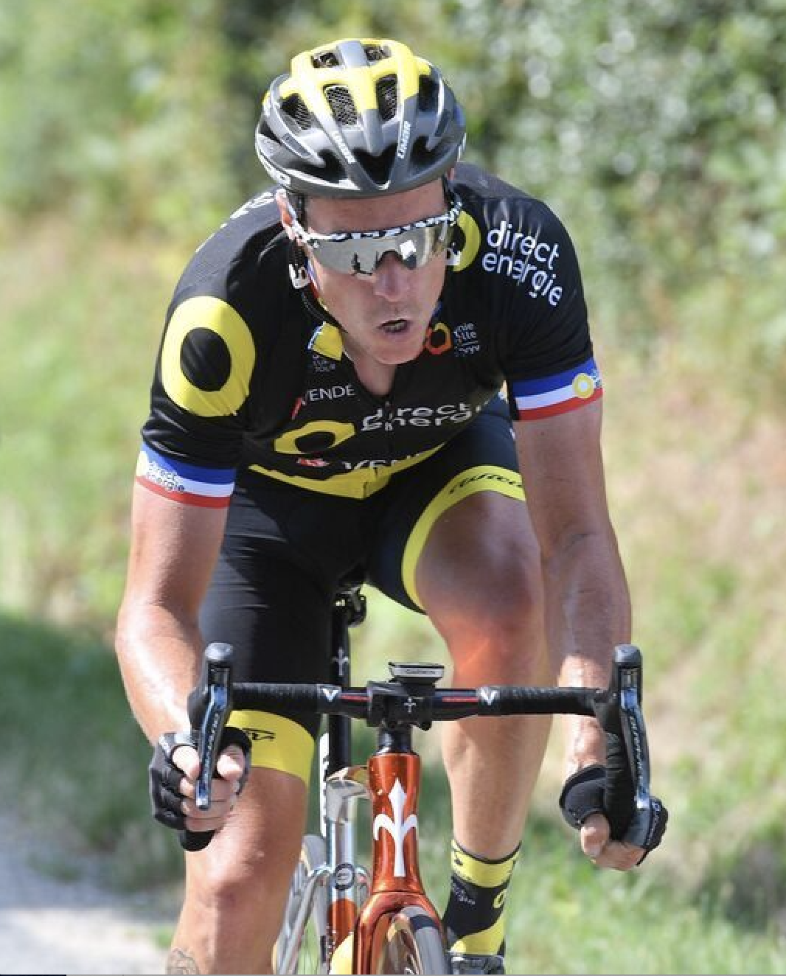
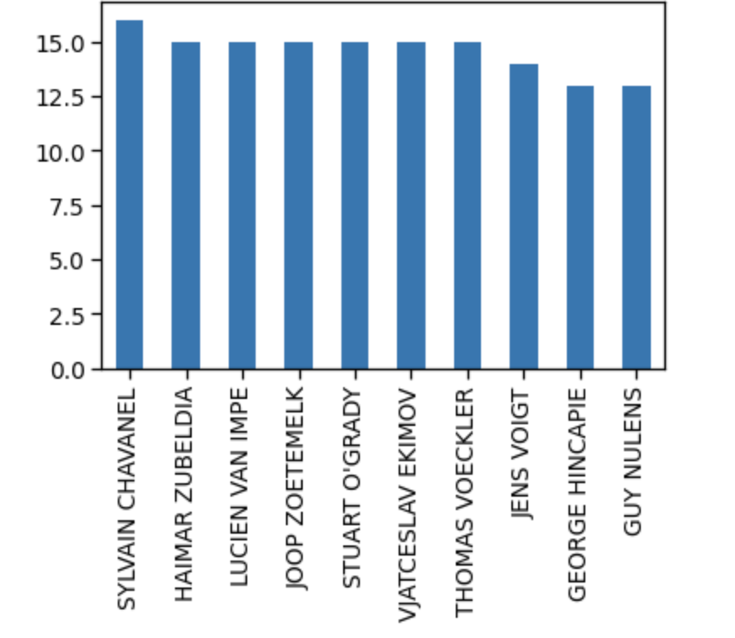
ANALYZING THE DATA
Riders who competed the most
French cyclist Sylvain Chavanel leads the pack with 16 entries into the Tour

Slide 6
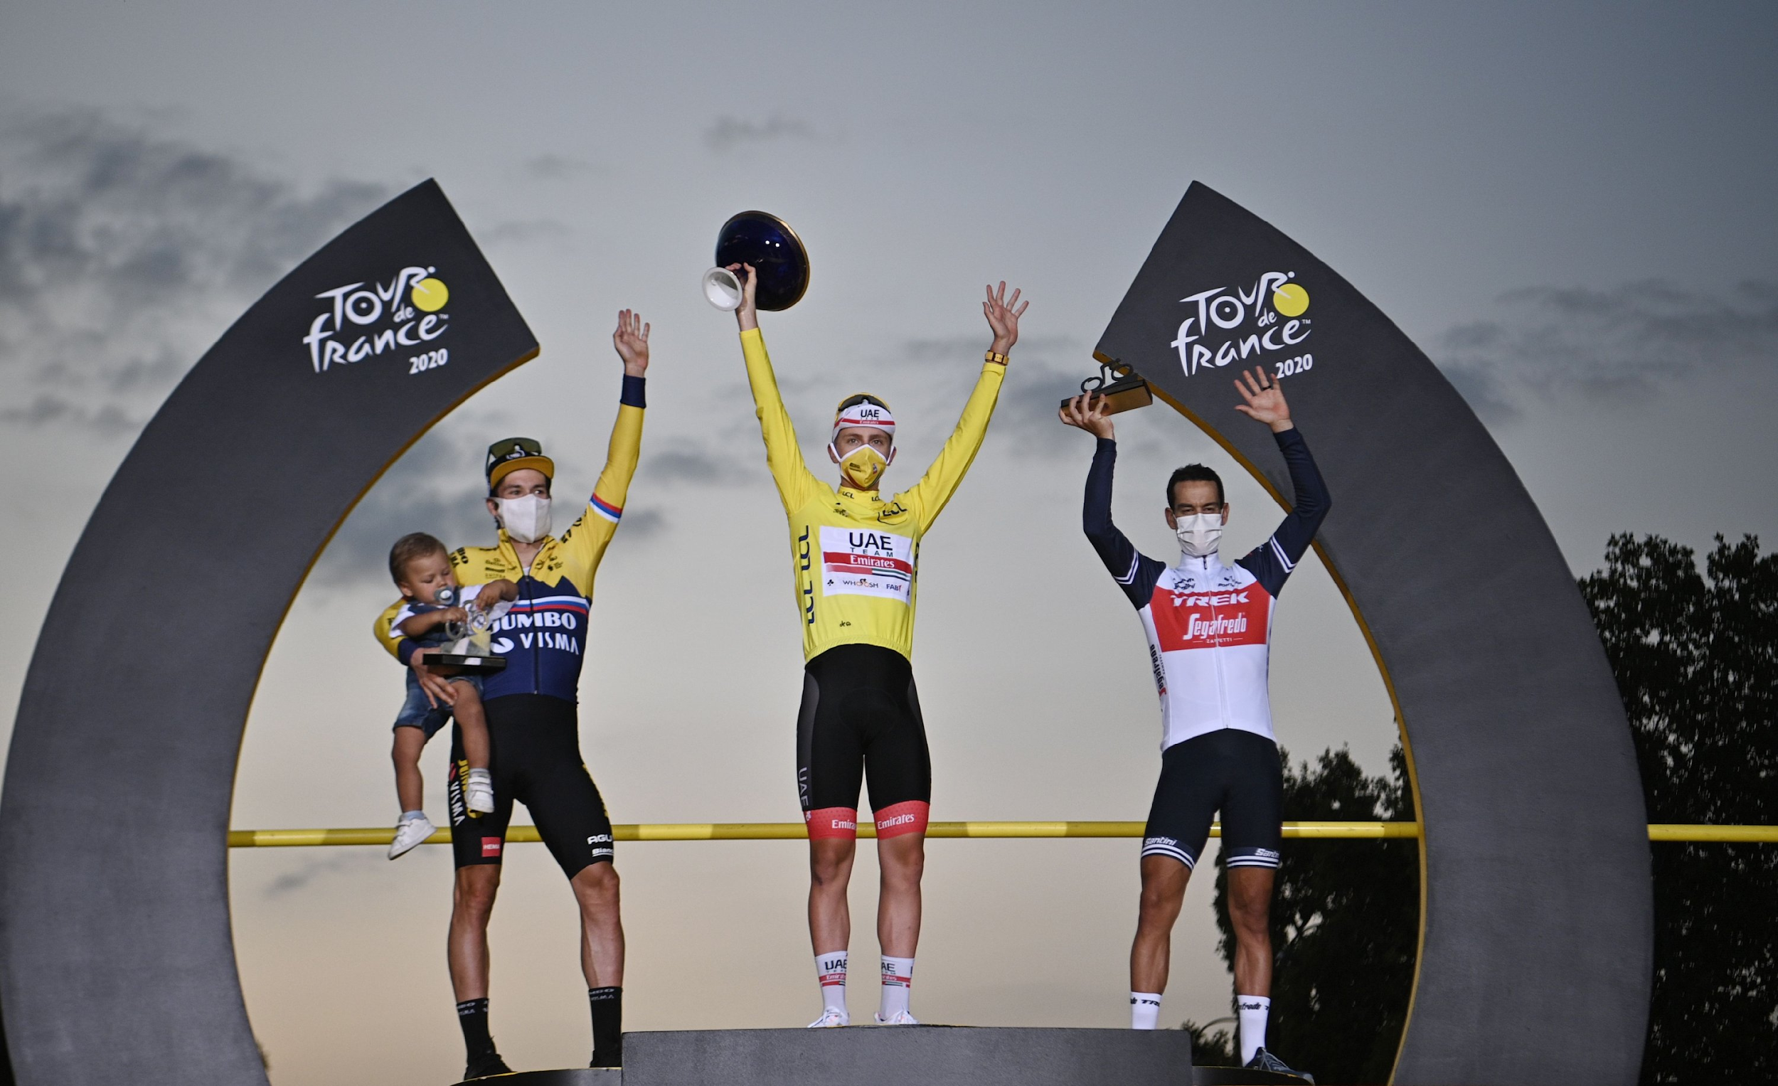
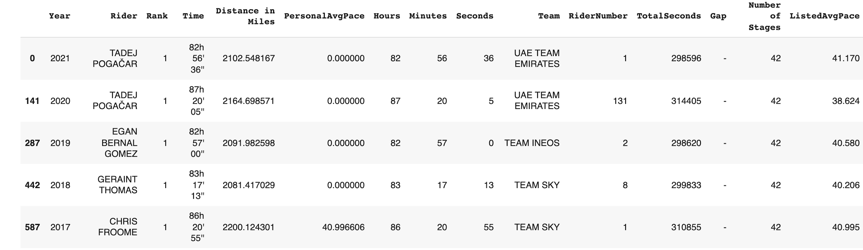
Analyzing the Data
WINNERS FROM EACH YEAR

Slide 7
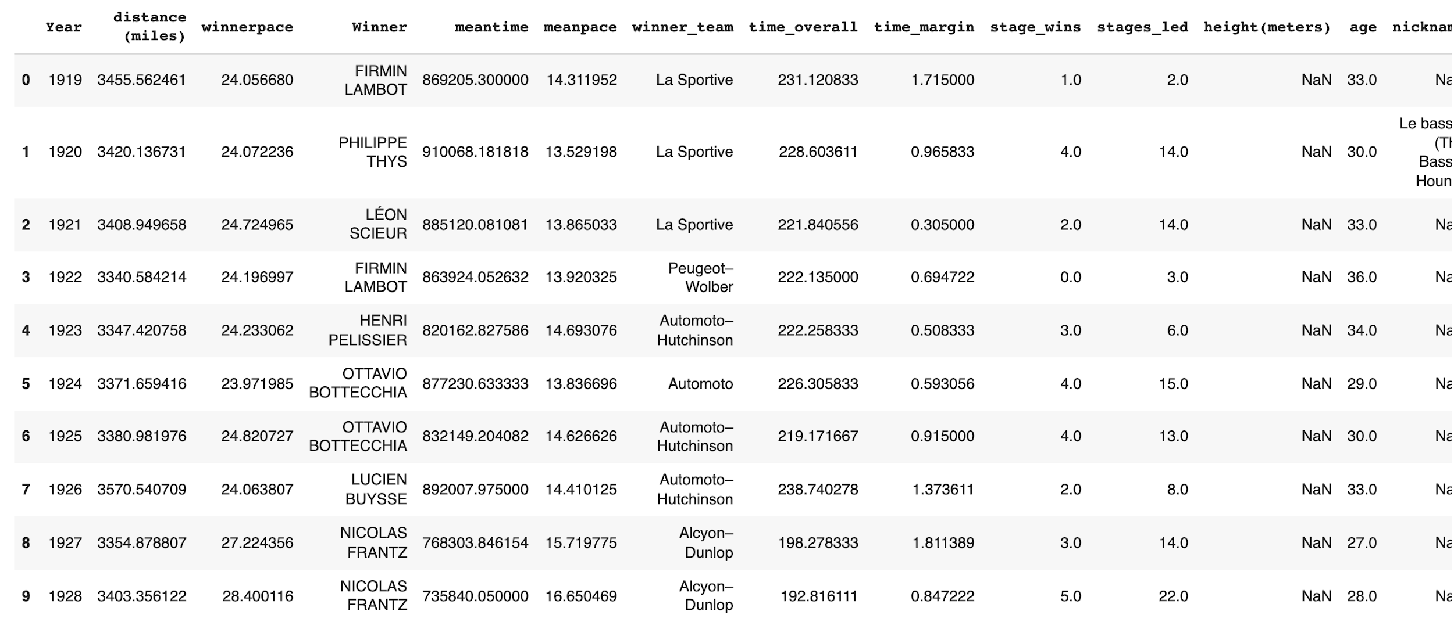
Merging Riders with Winners Dataset
Dataset from Kaggle on winner demographics
Data cleansing and preparation on the new dataset
Ensure the data types are the same in the merged data frame
Drop redundant columns
Want a more robust understanding of our winners

Slide 8
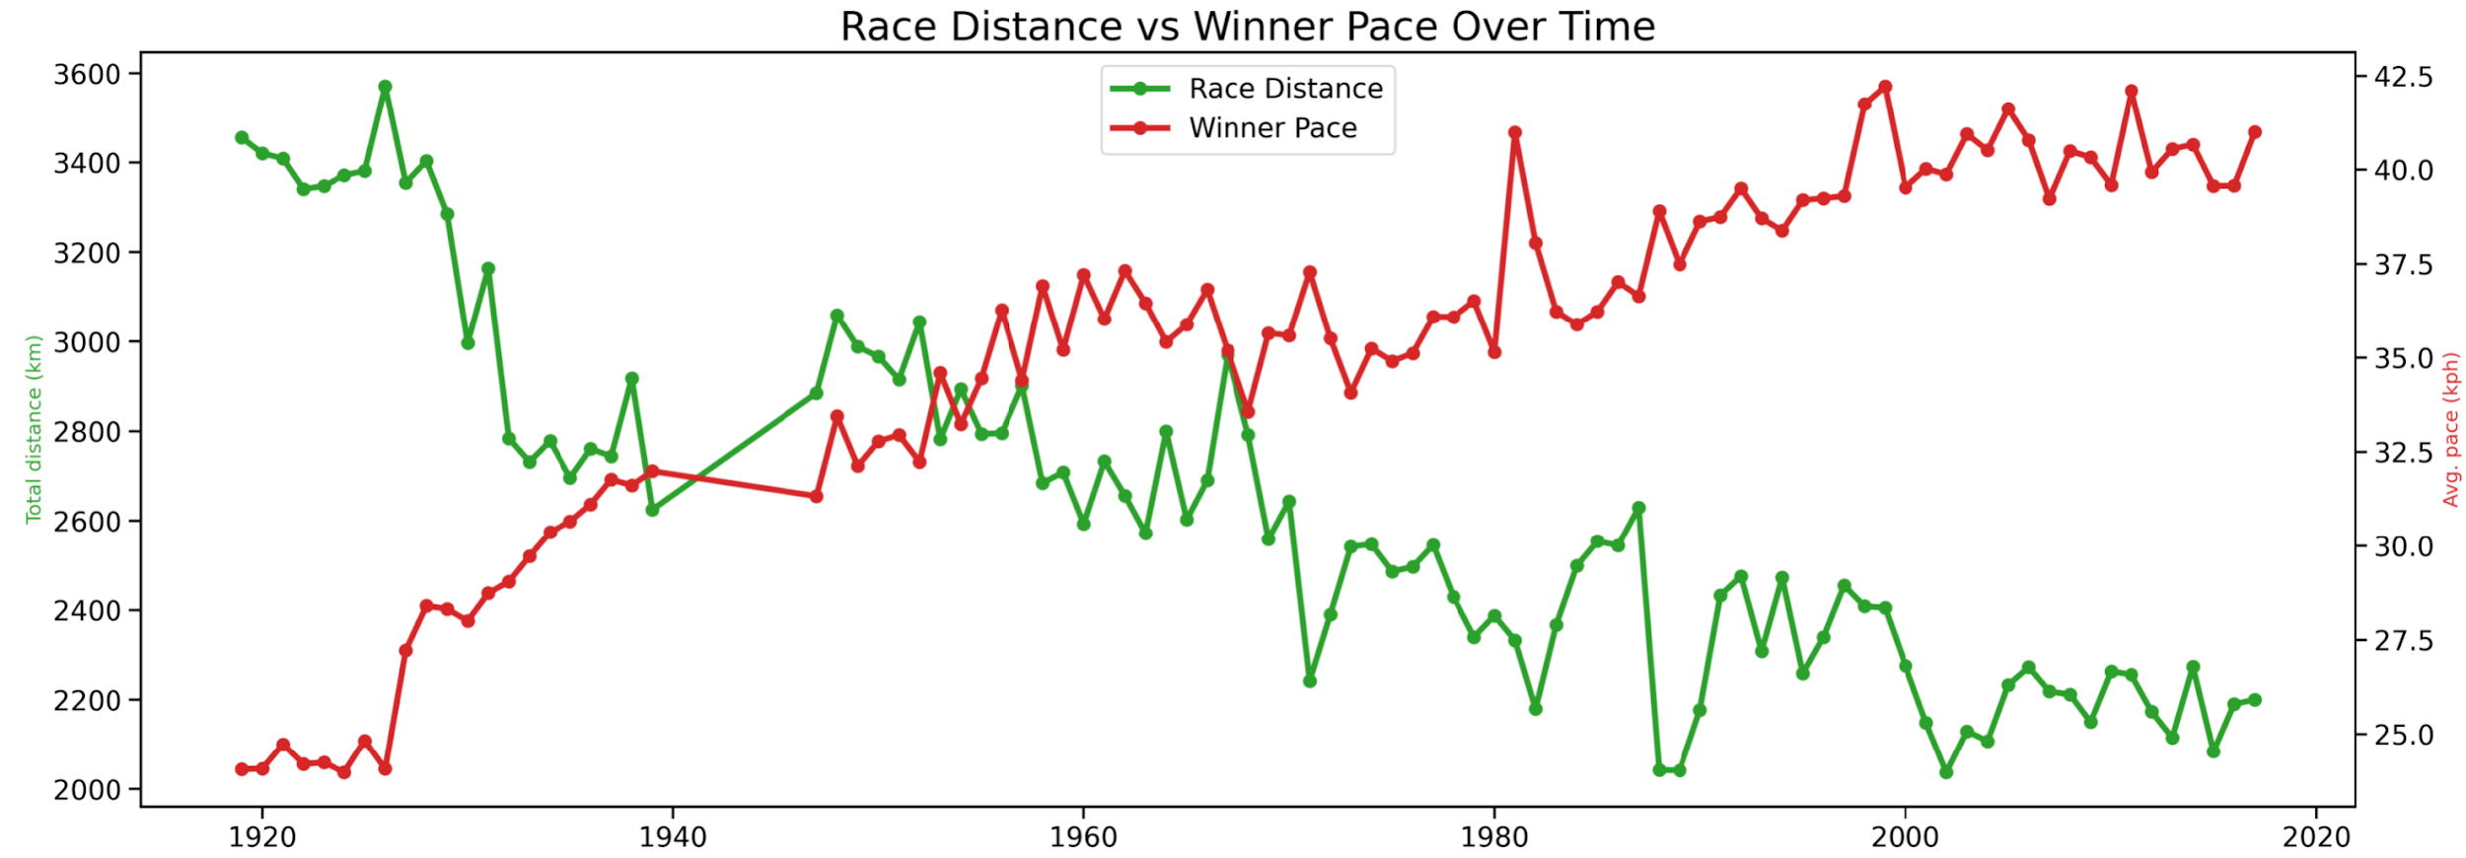
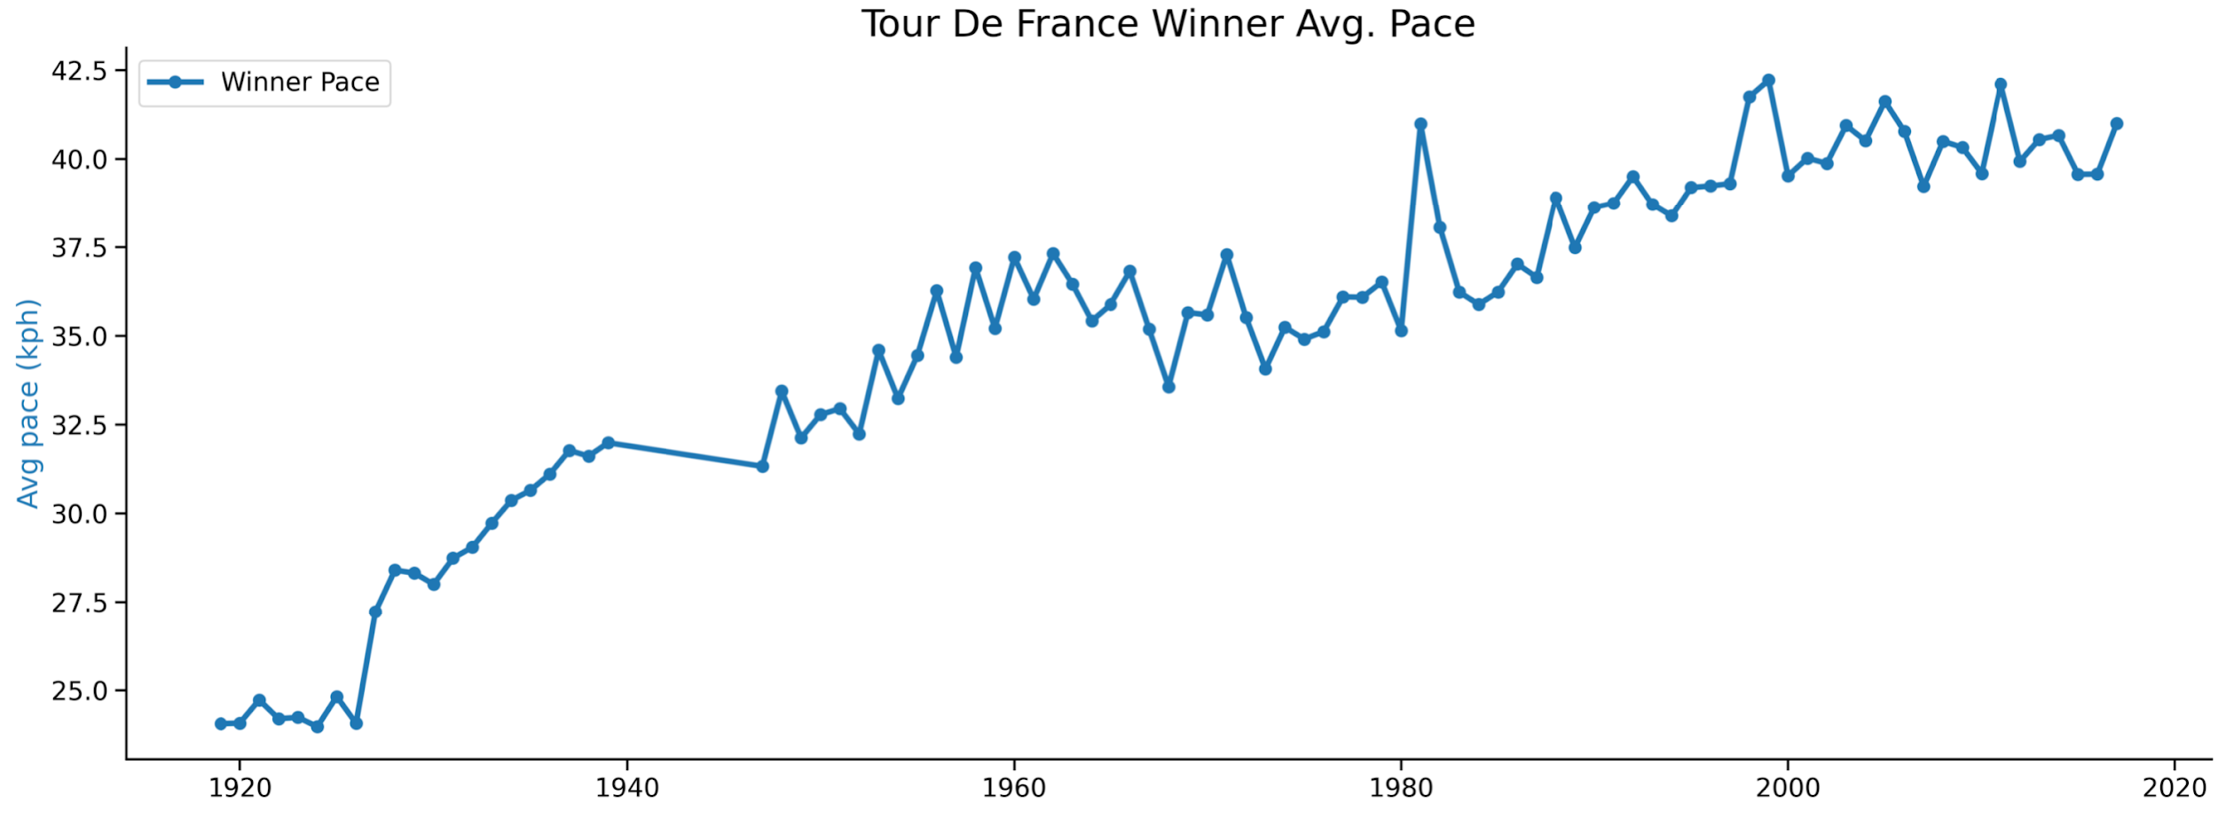
Visualizing the Data with Matplotlib, Seaborn, and Plotly
Winners have gotten faster over time
Compare winner's average pace with race distance

Slide 9
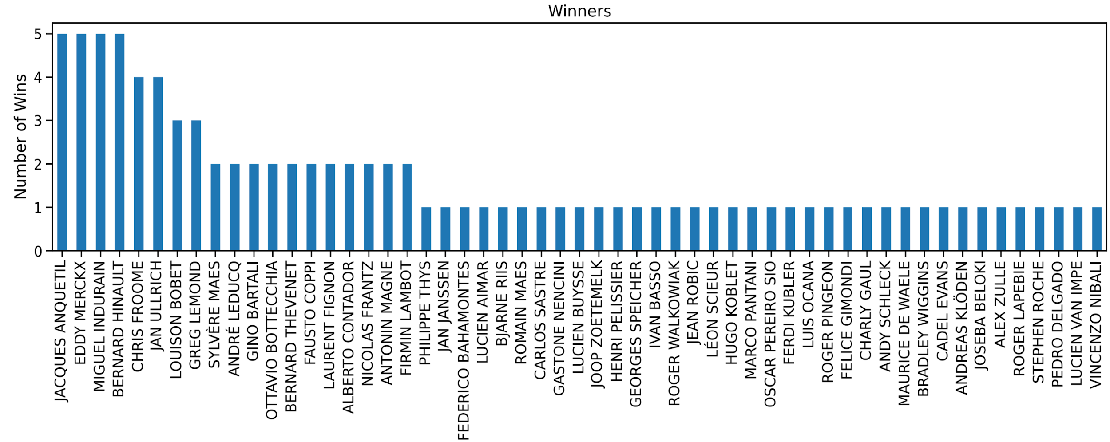
Visualize data by bar charts
Winners who have won multiple times

Slide 10
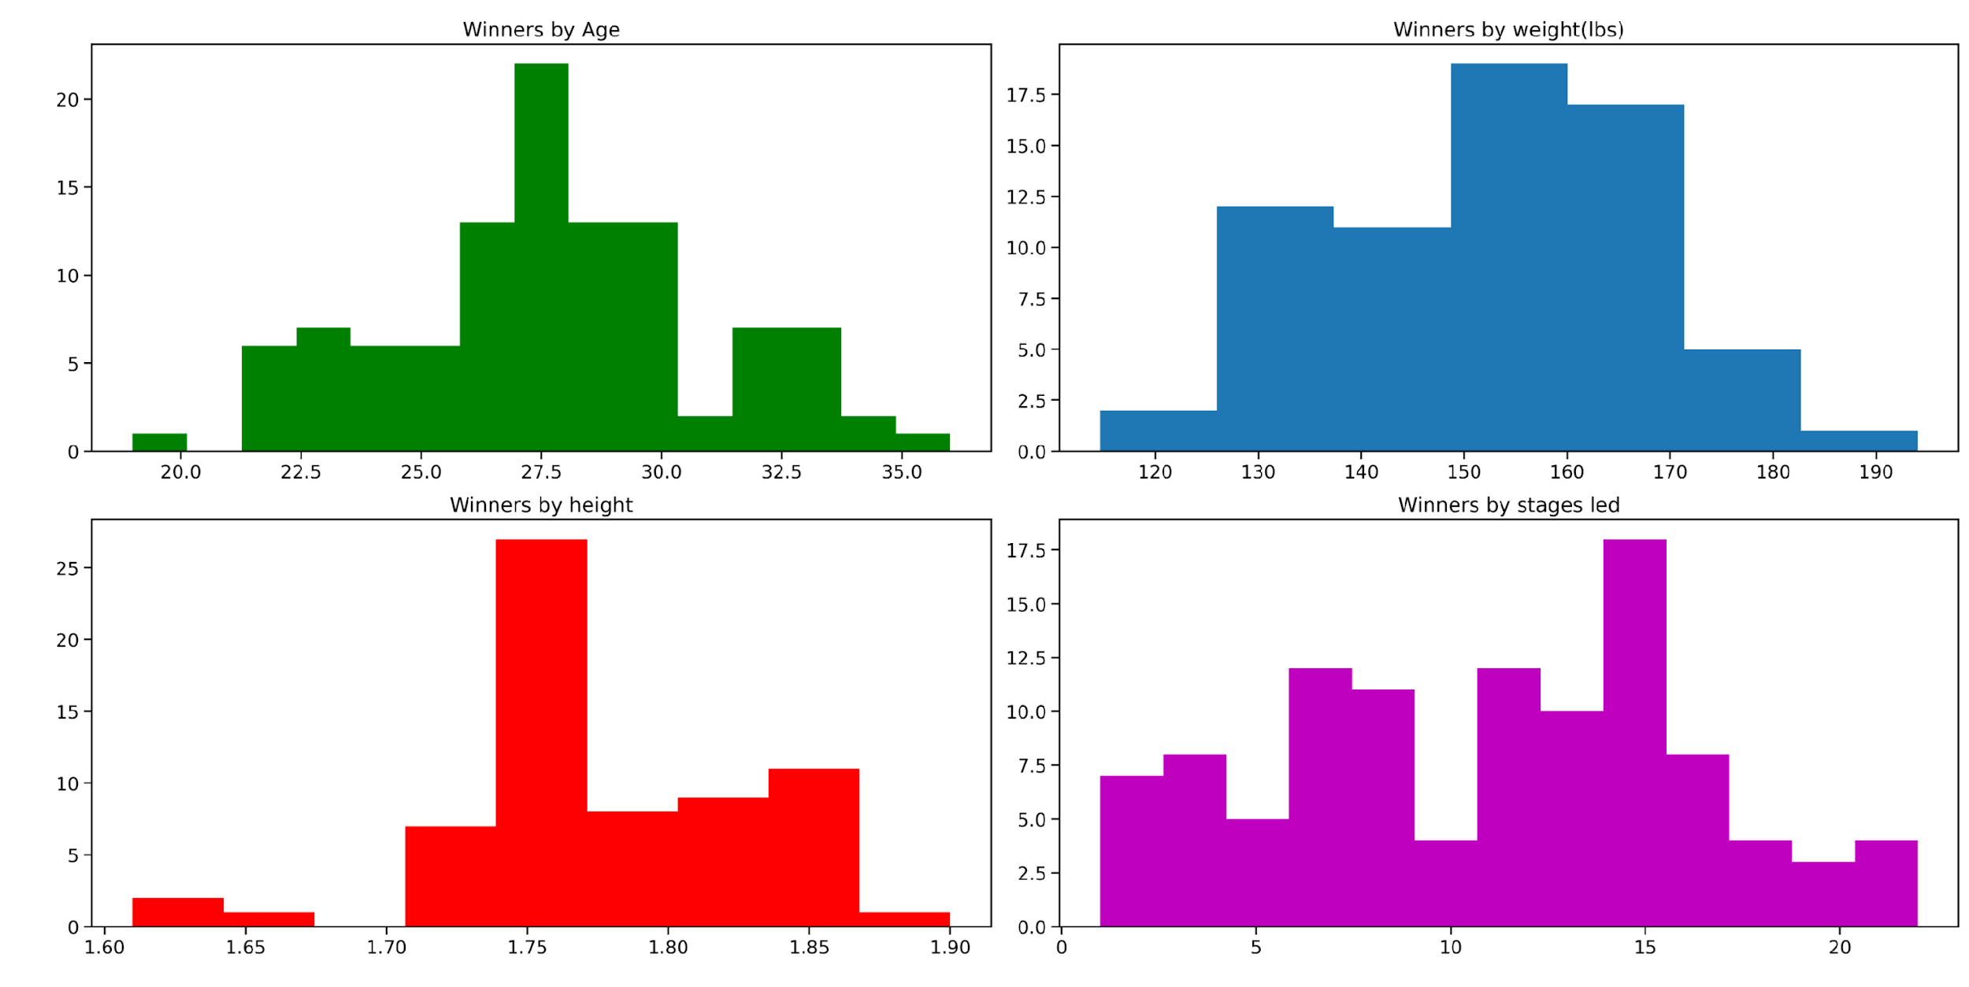
Age, weight, height and stage led distribution
Average Tour de France Winner’s Attributes:
Age - 28 Years old
Height - 1.78 Meters
Weights - 152.7 LBS.

Slide 11
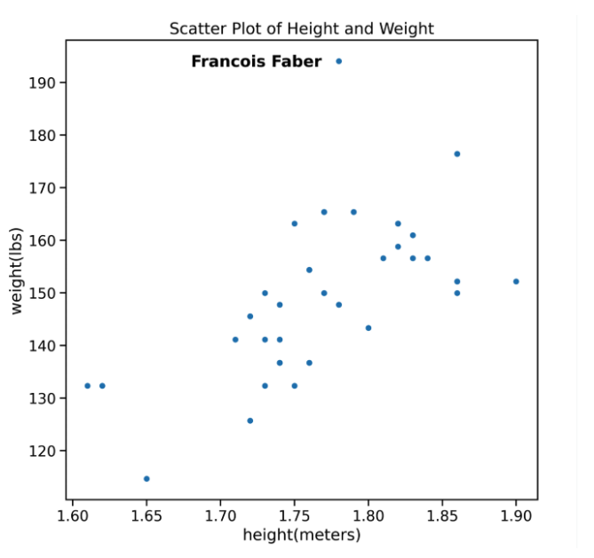
Scatter plot of Height and weight
Some quick filtering of our data quickly identifies the outlier as 1909 Tour De France winner Francois Faber, aptly nicknamed “The Giant of Colombes”.

Slide 12
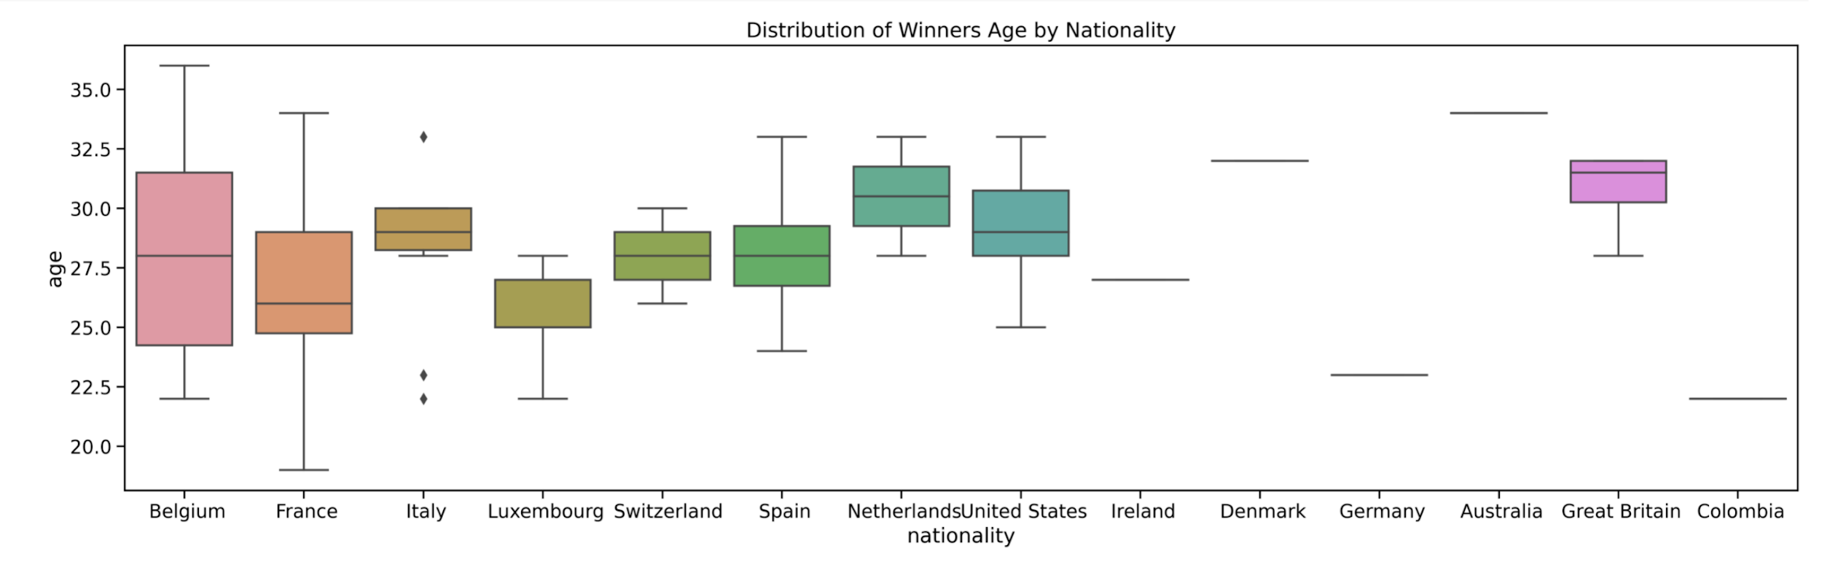
Boxplot of average winner ages grouped by nationality

Slide 13
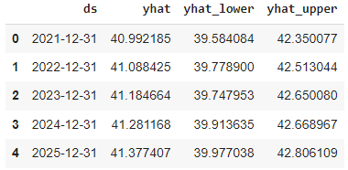
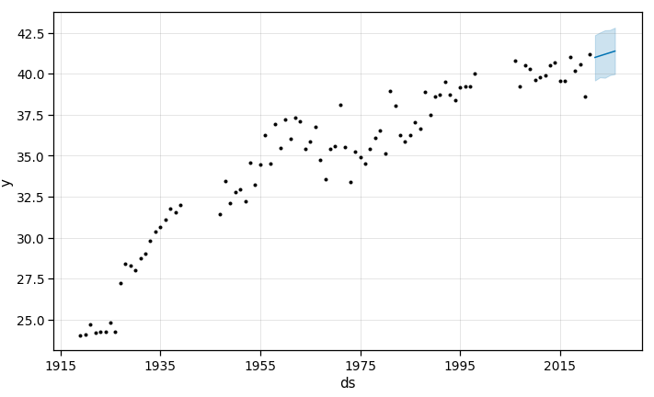
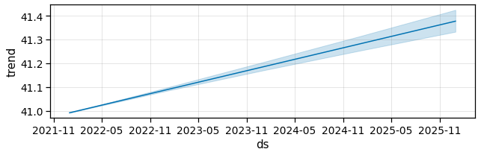
PREDICTIONS — USING AVERAGE PACE
Using the prophet model, we were able to determine that the pace of the winner is going to continue to increase over the next five years. The next year prediction for pace is 40.9 km/h.

Slide 14
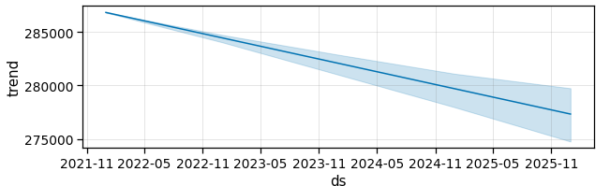
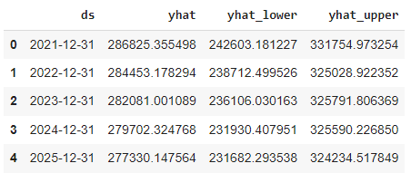
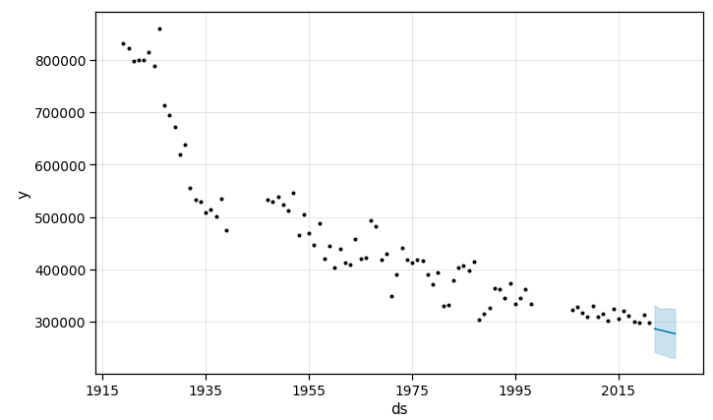
PREDICTIONS — USING TOTAL SECONDS
Using the prophet model, we were able to determine that the total time of the winner is going to continue to decrease over the next five years. The next year prediction for total time is 79:40:25.

Slide 15
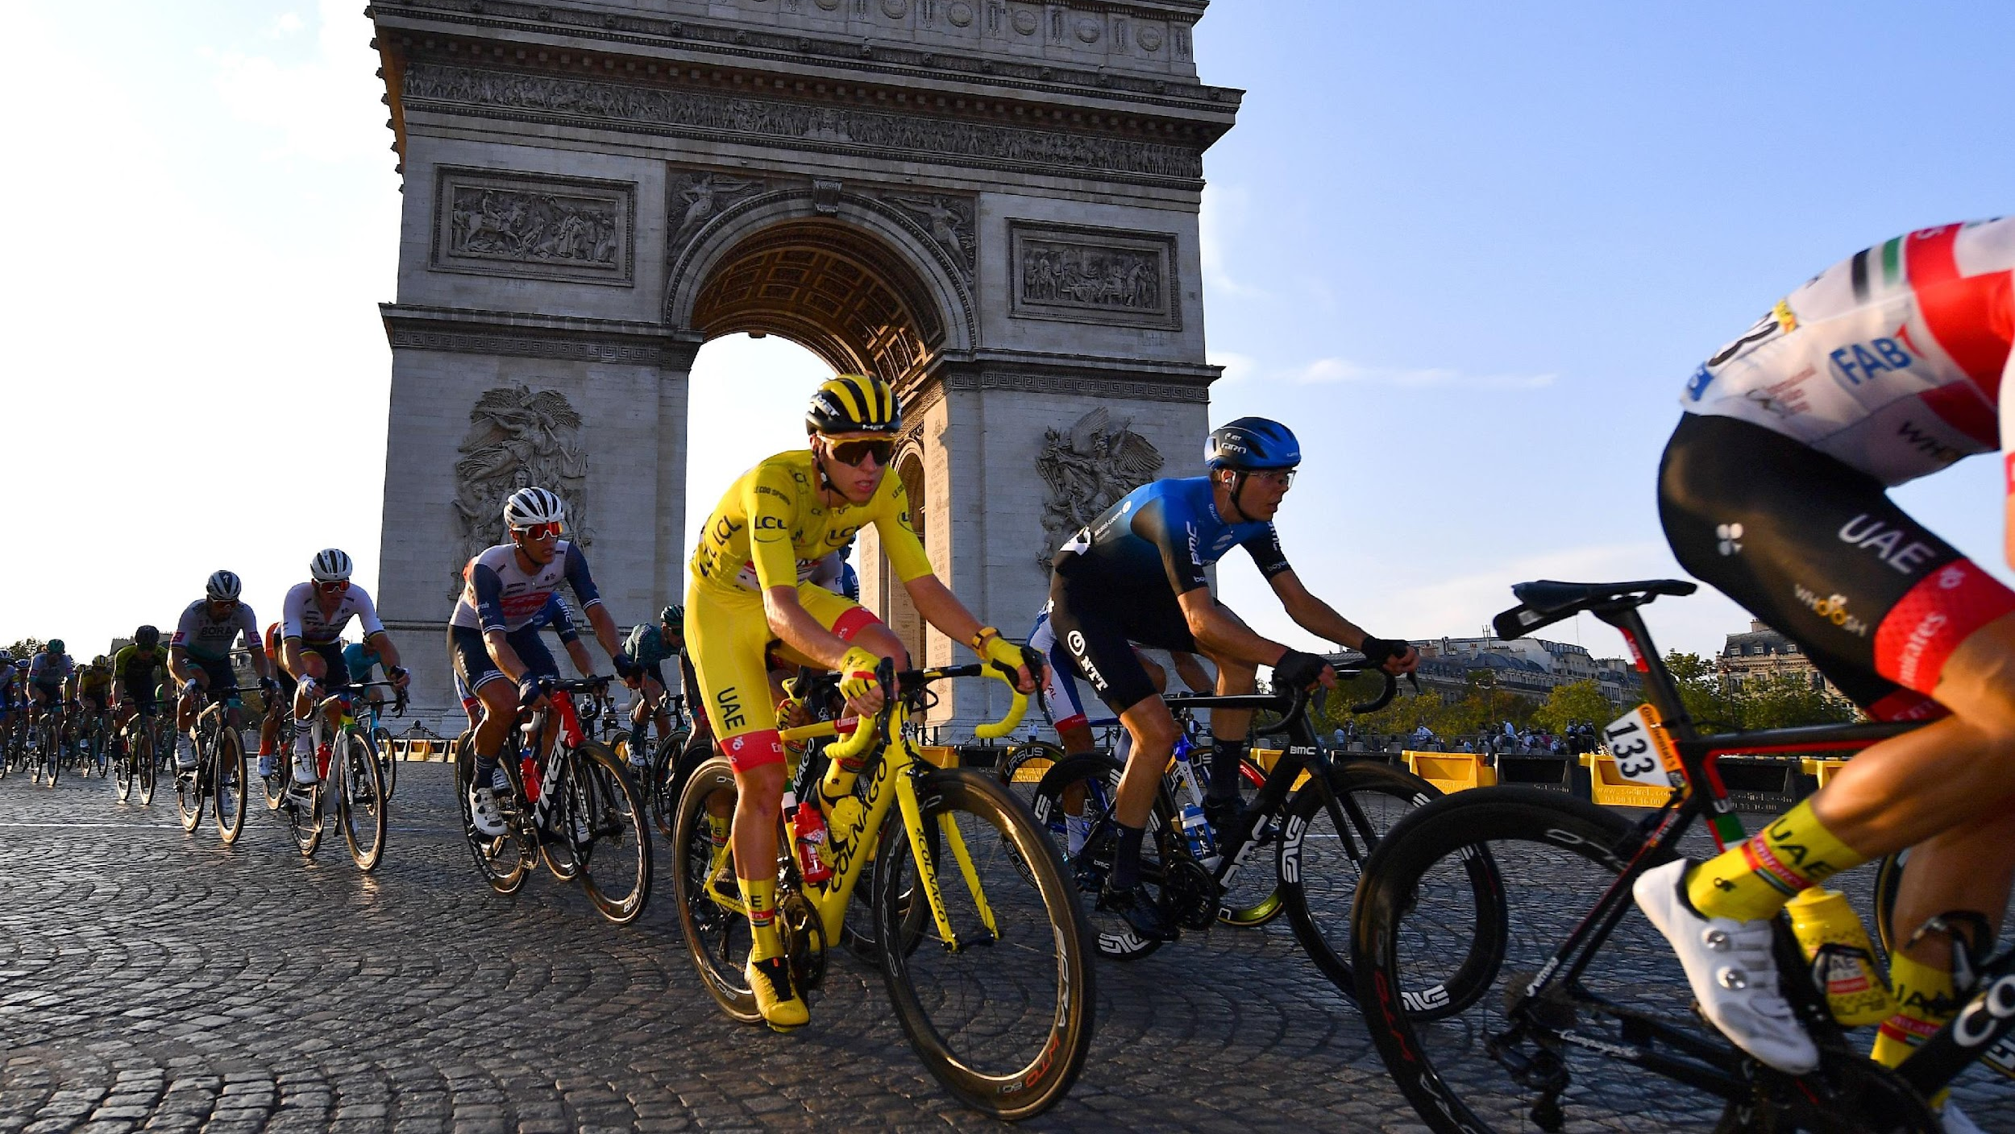
FINAL THOUGHTS
Tour de France is a highly competitive race with many interested in understanding how to estimate a winner
Winners of Tour de France will win by continuing to beat the previous years' winner's paces and times
Winners of Tour de France will likely be around 28 years old, 1.78 meters tall, and around 153 pounds

Slide 16


